Slide 1




Ming Wu (Andrew) 2133861w
Laser Mate!
Project Supervisor Meeting 8
29 December 2020

Slide 2
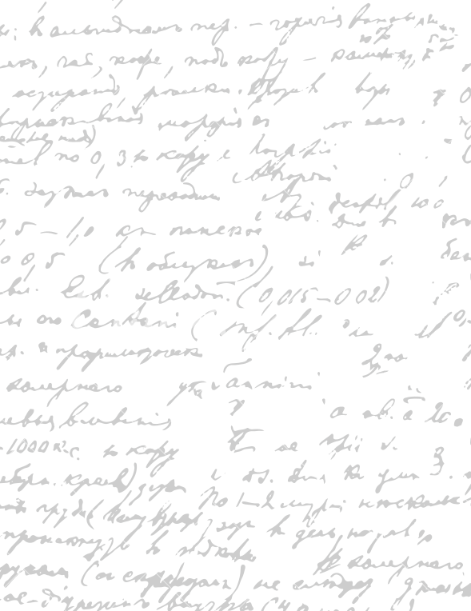



Start Recording

Slide 3
Main Topics
Current Progress
Software TechStack
Development Strategy

Slide 4



100% Confident
Convert front-end design to react.JS code
Display data on the web from the database
Send an automatic email to myself when a client makes a registration request on the website
Working on It
Create four different user account types (waiter + chef & restaurant owner & company staff & CEO)
Create a complete database
Create user the login, register and signup page for the 4 user account types
Render data differently for the 4 different user types and for uniquely for each user within the same user type
Testing Database API function accuracy using Postman
Email Automation for User Registration
Current Progress

Slide 5
Software TechStack
- General: Django
Database: PostgreSQL, Django Rest Framework API
Front-End: React.JS, Anima
Design: Adobe XD
Testing: Postman
Email Automation: Gmail
Based on Instagram TechStack

Slide 6
1. Find a collection of relevant programming tutorial videos
First look at the final product and see if (in this order) it is coded in React.JS and Django. Whether it has the login/logout/ register features, and data rendering based on the database (ideally with various database). Finally, look in the code base and see if it is coded nicely. (Not on LinkedIn because the final products are too basic)
2. Once you gathered over 5-10 example website codes, priorities the videos and codebase that are closest to your product and start watching the videos to learn the different aspects of the website.
You must follow the 5 hours videos because you can’t clone a template project from other people and make it your own (ask supervisor). It keeps having the submodular problem where your code doesn’t show in GitLab.
3. Copy and paste the code from the template project while watching the video guides to gain understanding of the system.
Development Strategy

Slide 7
Questions
1. Have you ever come across needing to clone a template project from another stranger developer and you need to push their project to your Git repository? How did you push the project so that the submodular problem gets solved?

Slide 8
End

